Slide 1
HOW TO PREPARE A RESEARCH PROPOSAL
Edited By: Dr. Riddhi Sanghvi,
Head, Department of Management

Slide 2
Introduction to Research Proposal
A research proposal should answer the following questions:
What: A research proposal should present your idea or question and expected outcomes with clarity and definition
Why: It should also make a case for why your question is significant and what value it will bring to your discipline

Slide 3
Why is it important?
Research proposals are significant because it formally outlines your intended research.
Which means you need to provide details on how you will go about your research, including:
your approach and methodology
timeline and feasibility
all other considerations needed to progress your research, such as resources.
Think of it as a tool that will help you clarify your idea and make conducting your research easier.

Slide 4
What a Research Proposal should include?
Cover page and Title page:
Things to remember:
Research title - Your title should clearly indicate what your proposed research is about

Slide 6
What a Research Proposal should include?
2. Abstract
To present the essential meaning of the proposal, the abstract should summarize:
KEYWORDS: 3 to 4 words
BACKGROUND: the significance (need) of the work,
MAJOR OBJECTIVES: including the proposed hypothesis
THE PROCEDURES/ MATERIALS & METHODS: to be followed to accomplish the objectives, and
THE POTENTIAL IMPACT/OUTCOME: of the research

Slide 7
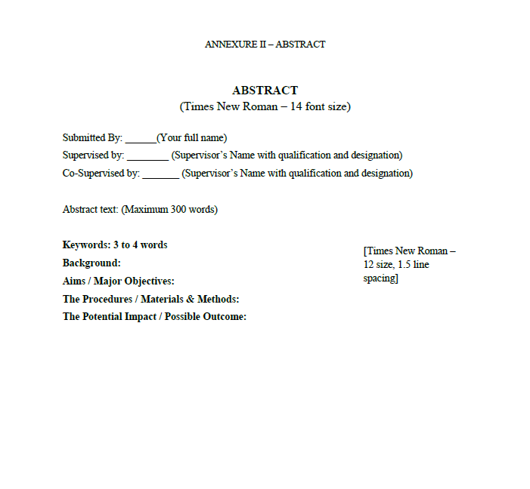

Slide 8
What a Research Proposal should include?
3. Table of Contents:
List of all the key headings along with their page numbers in appropriate format as follows:
Fonts: Times New Roman
Size: 12, centrally aligned

Slide 9
What a Research Proposal should include?
4. Introduction: (1 or 2 pages)
Introducing the key aspects/points relating to the title of the research.
Stating relevant facts and figures
Explaining the need/feasibility of the research topic

Slide 10
What a Research Proposal should include?
5. Review of Literature:
The literature review demonstrates the applicant’s knowledge of the main research achievements in the area of study.
You should pay attention to providing some of the key references in your area of research which requires doing extensive research on your part
Things to remember:
Indicate present status of research work in the area of your research topic and in the light of your objectives

Slide 11
What a Research Proposal should include?
6. Research Methodology:
This should include:
Research Problem / Problem statement
Objectives
Materials & methods: (this should include)
3.1: Research design: (Descriptive/Exploratory/Causal)
3.2: Sampling plan: (sampling frame, sampling technique/sample size)
3.3: Data Collection methods and tools: (Primary/Secondary)
3.4: Data Analysis tools
3.5: Proposed Hypothesis

Slide 12
What a Research Proposal should include?
7. Plan of work:
You can either divide the proposed research work in stages like stage 1, stage 2, and so on..
OR
The entire research can be divided into units/parts comprising of the tasks to be achieved in the duration of every 6 months (which can be presented in respective Doctoral Progress Committee)

Slide 13
What a Research Proposal should include?
8. Possible Outcomes of your research
The possible outcomes can be listed with bullets stating their impact or contribution to the concerned domain/faculty/research discipline

Slide 14
What a Research Proposal should include?
9. References:
The references should be arranged alphabetically.
The required reference style is APA (American Psychological Association)
Detailed guidelines for the same can be retrieved from the following URL:
https://www.mendeley.com/guides/apa-citation-guide/

Slide 15
Thank you

